Slide 1
Facial Emotion Recognition
Team Name: Hack Street Boys
Gireesh Kumar Muppalla
Ajay Kumar Kancharla
Mohan Reddy Tamma
Vishnumonish Kankanala

Slide 2


Project Objective:
The main objective of our project is to Identify the emotions of a person.
In general, the human can detect the other human emotions by looking at the face.
In this project we train the machine to detect the human emotion by artificial neural networks.

Slide 3
Dataset
_______________________________________________________________________
Dataset Used is FER2013
Source
________________________________________
Kaggle

Slide 4
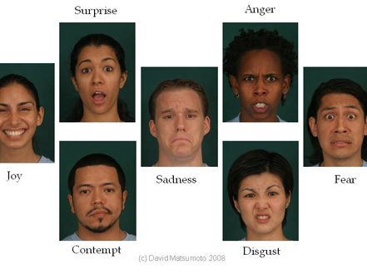
Emotions to classiFy

Slide 5

Technology
Deep Learning

Slide 6
State of Art model Used : Mini_Xception
Libraries used:
Tensorflow, Keras, Sklearn & OpenCV

Slide 7
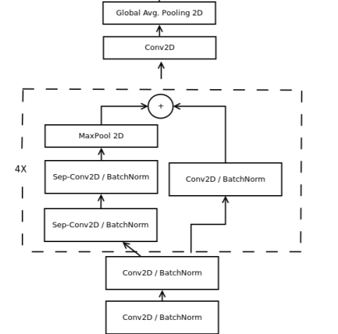
Architecture:

Slide 8
Technical Implementation
Data Load
Data Pre-processing
Creating the Mini-Xception Architecture
Training the model
Performance Evaluation

Slide 9

Data Loading
Images
emotions

Slide 10
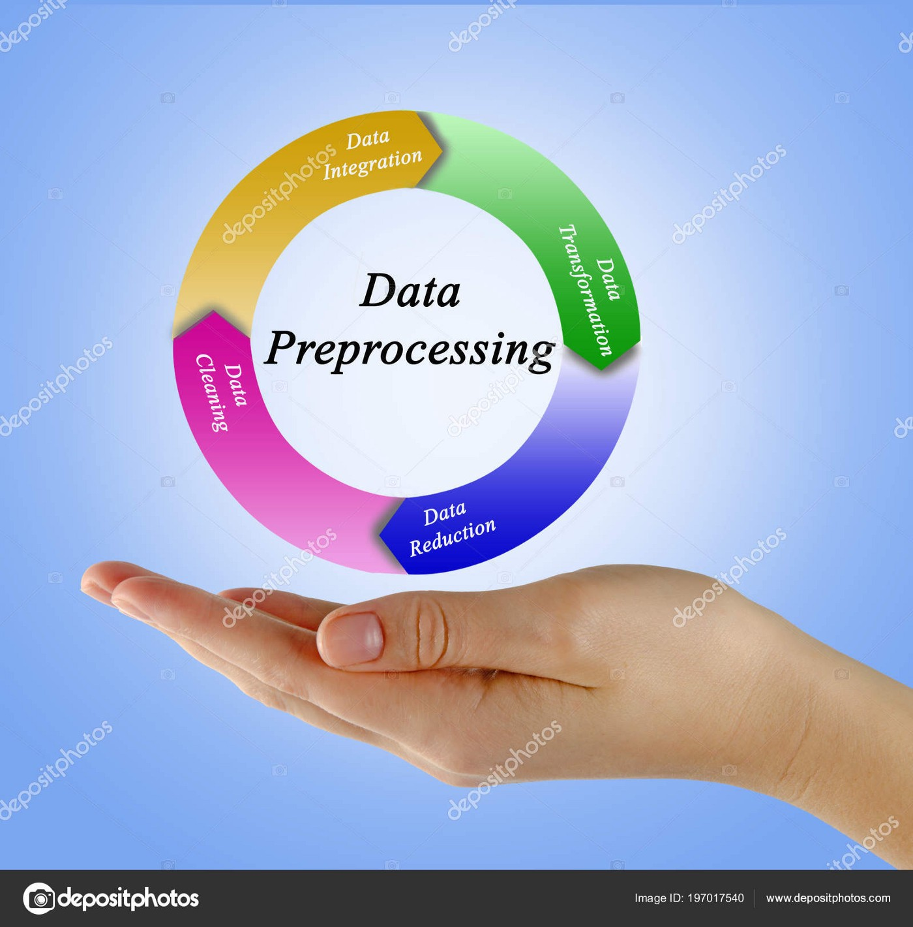
2. Pre-processing
RGB to Gray Scale
Resize
One Hot Encoding

Slide 11
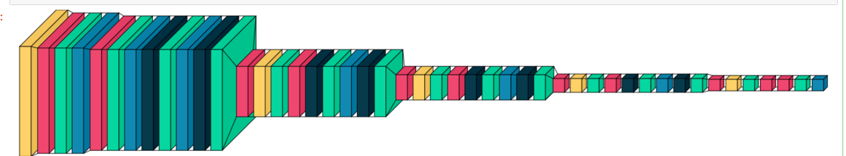
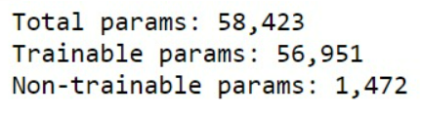
3. The Mini-Xception

Slide 12

4. Training
36,000 samples
80:20 train to test ratio
Epoch: 110, each epoch time:210 seconds on CPU.

Slide 13
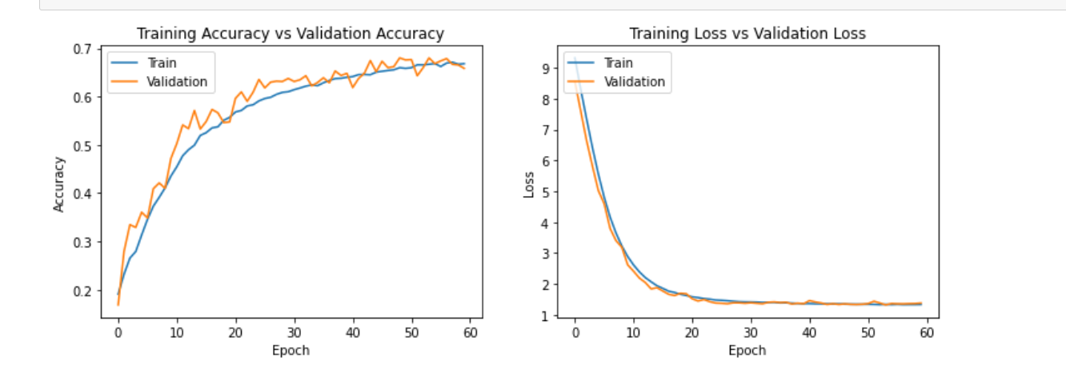
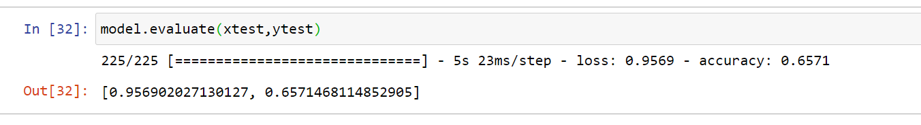
PERFORMANCE EVALUATION

Slide 14
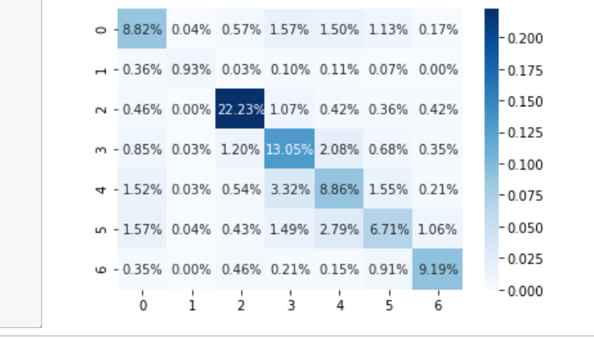
Confusion Matrix
0:'angry’, 1:’disgust’, 2:'scared’, 3:'happy’, 4:'sad’, 5:'surprised’, 6:'neutral'

Slide 15
Models Comparison
Model Used | Accuracy
VGG-16 | 63.19
ResNet-18 | 63.9
VGG-19 | 63.97
VGG-Face | 64.15
Mini_Xception | 65.7

Slide 16
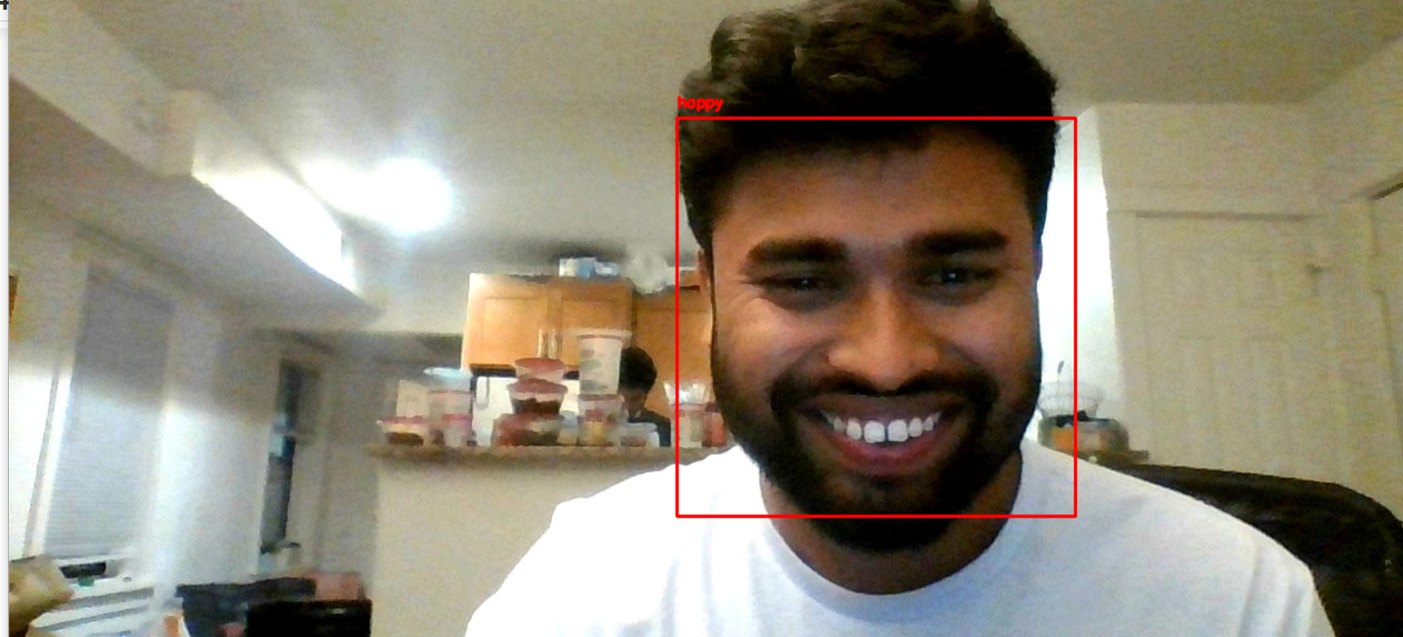
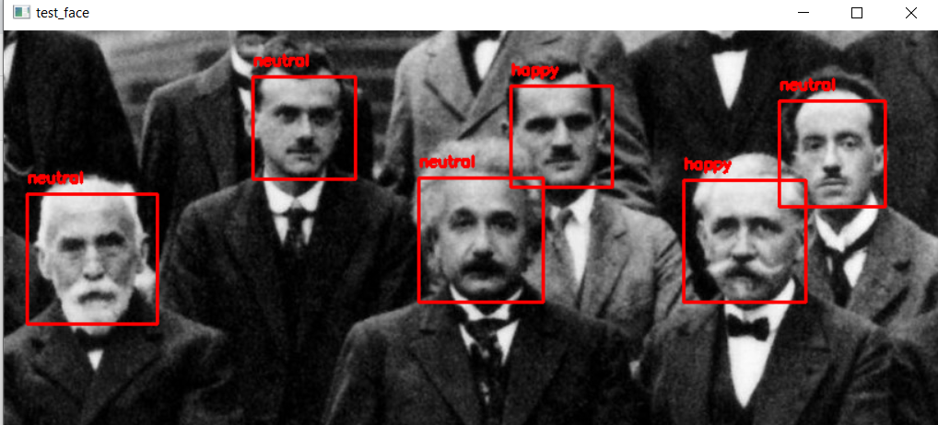
Emotion Recognition on Single Image
Emotion Recognition on Image with Multiple faces

Slide 17
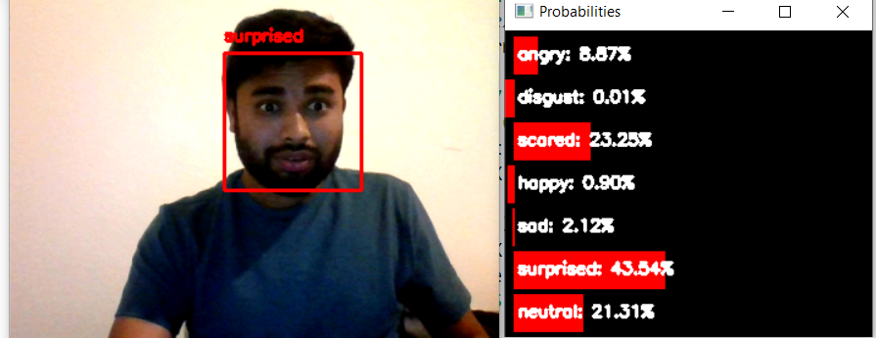
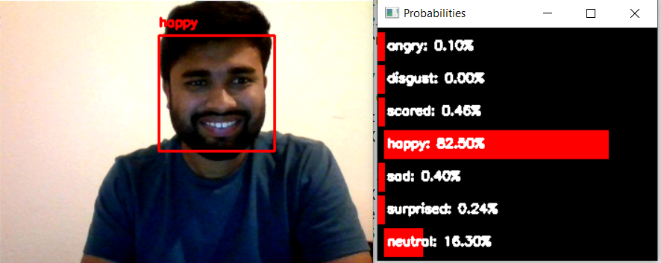
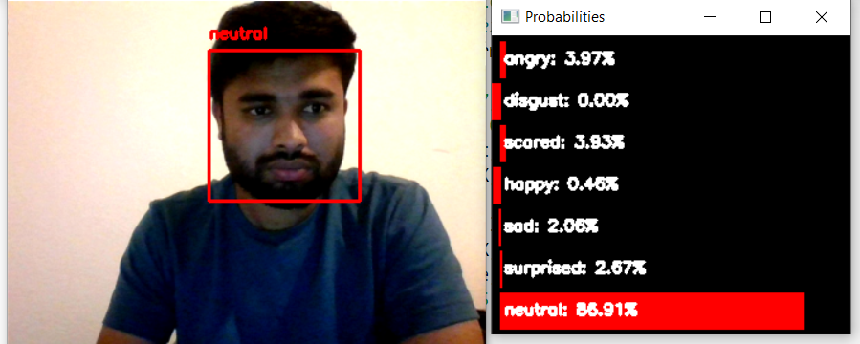
Testing the FER model on a video steaming on a webcam

Slide 18

Future Scope
Can be employed for employee wellness who are WORKING FROM HOME.
Deepfake Detection.
Psychometric examinations

Slide 19

Queries?

Slide 20

Thank You

